Slide 1


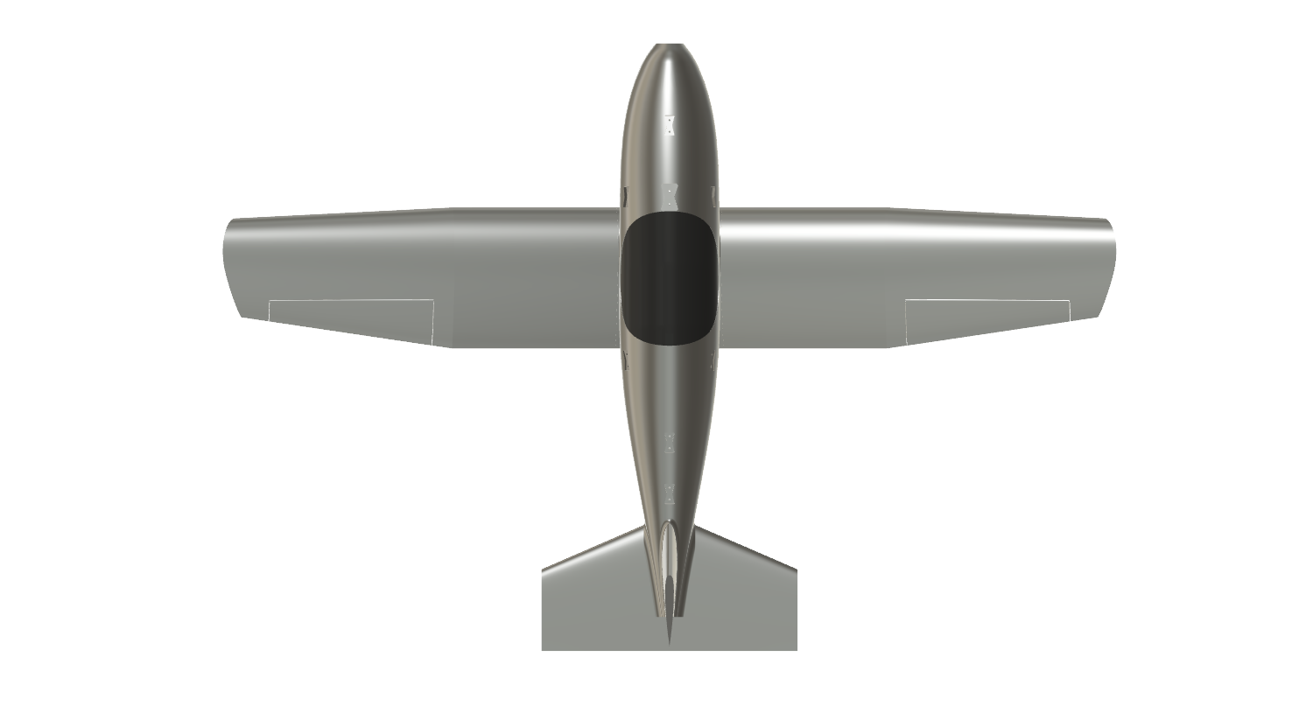
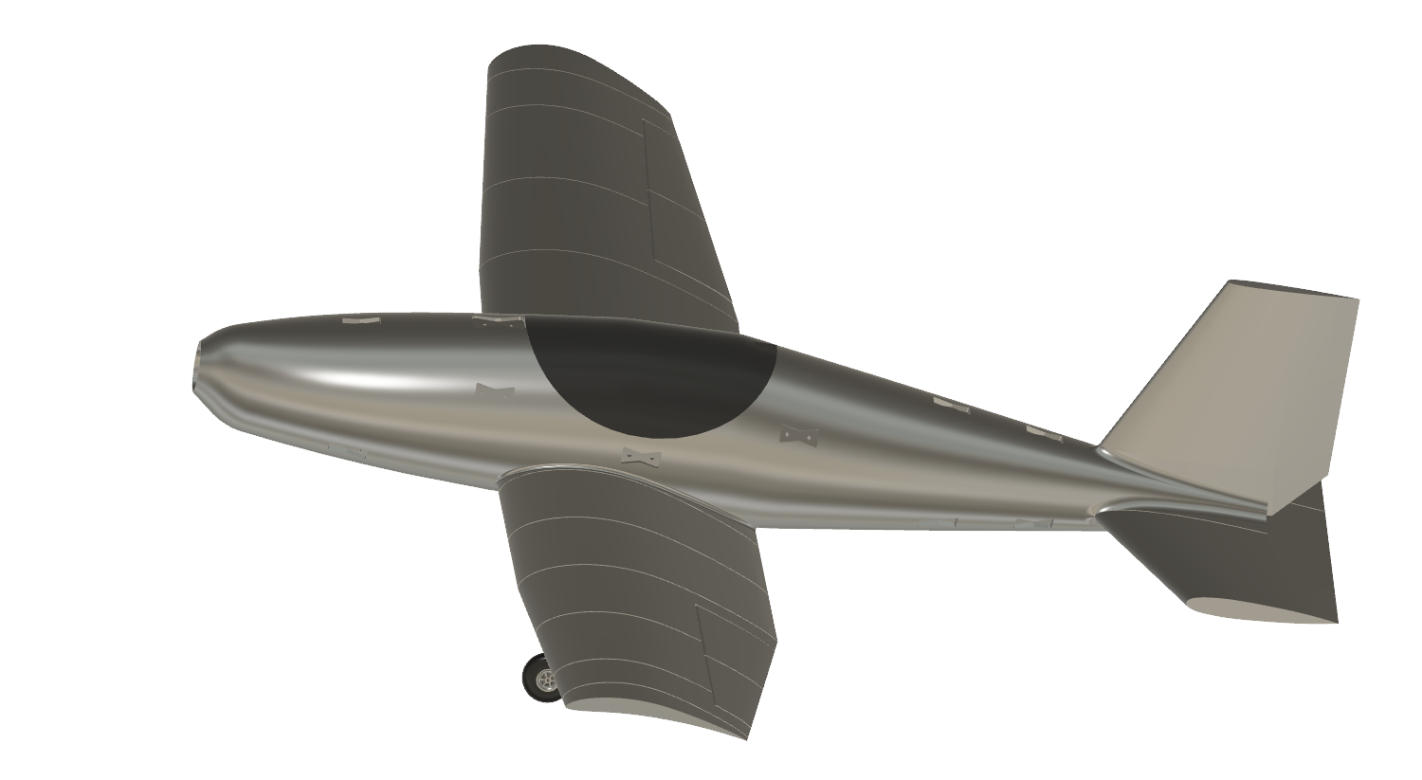
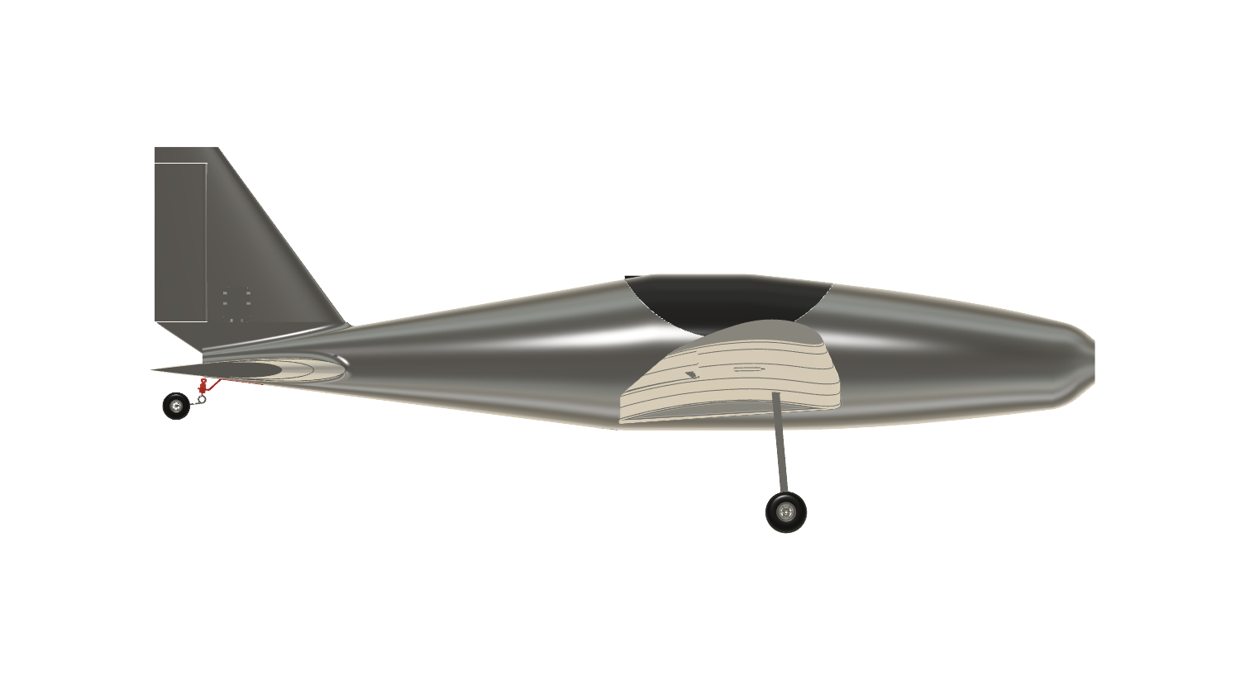
Additive Manufacturing in Aerospace
Team 508: David Jay | Michael Nalovic | Sofia Rodriguez | Tristan Wahl
‘
Objective: Design, Build, and Manufacture a 3D Printed Remote Controlled Plane
Wings
Rectangular Tapered Shape
Eppler 423 Airfoil
83 inch Span
Rectangular Aluminum Spars
Hoerner Wingtips
5 Degree Dihedral
Tail
Conventional Tail Design
NACA 0012 Symmetrical Airfoil
Horizontal Stabilizer
  12 inch root chord
  25 inch span
Vertical Stabilizer
  12 inch root chord
  12 inch height
Control Surfaces
4 Independent Control Surfaces
  Ailerons
  Rudder
  Elevator
  Throttle
6 Channel Receiver
20 Degrees Actuation
Manufacturing
Material: Lightweight PLA
Activated Density: 0.403 – 0.476 g·cm³
Design Weight: 15 lbs.
Estimated Final Weight: 15.2 lbs.
Notes:
Include the props

